Slide 1
Preparation by International Bussiness Department
Sample Preparation and Accelerating Chemistry Research with Microwave Technology

Slide 2
CONTENTS
01
02
03
OVERVIEW
PRODUCTS
ADVANTAGE
History/ Introduction
Microwave Digestion/ Extraction/Synthesis System
What We Have?/ Benefits

Slide 3
30-year Experience in R&D of Microwave Instruments
Records in the World
No vessels explosion record in the world (10,000+ units installation)
One round digestion up to 100 vessels, highest throughput in the world.
Free lifetime for core component - Magnetron.
Highest micorwave output power in the world - 2200W
Unique pressure monitor method - Piezoelectric Crystal.

Slide 4
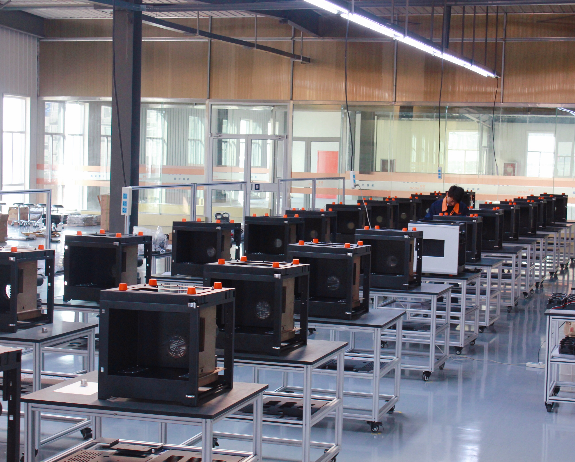
#2
PRODUCTS

Slide 5
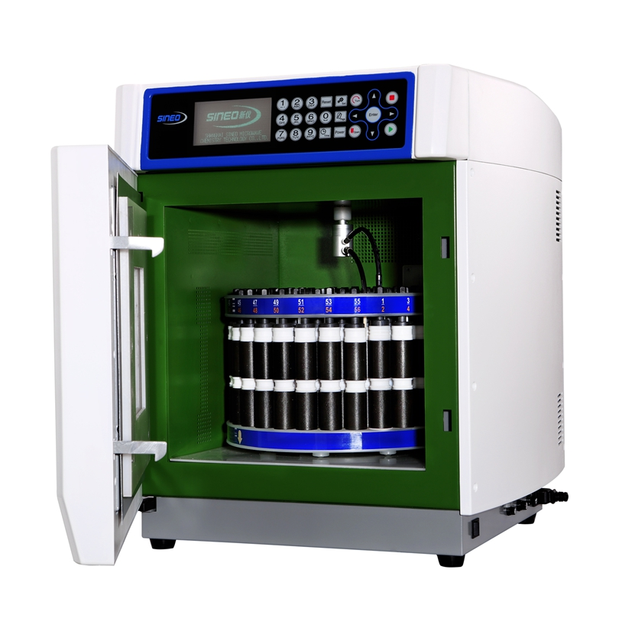
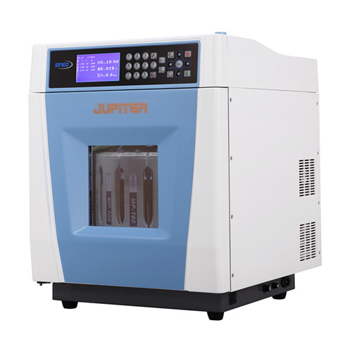
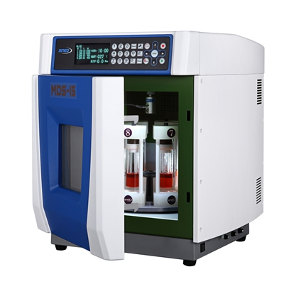
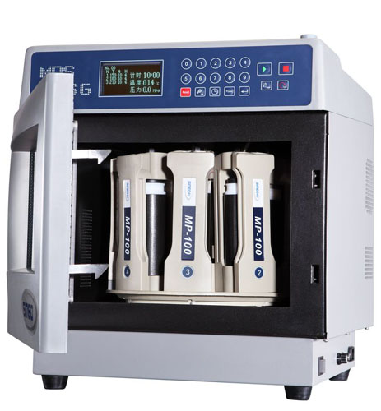
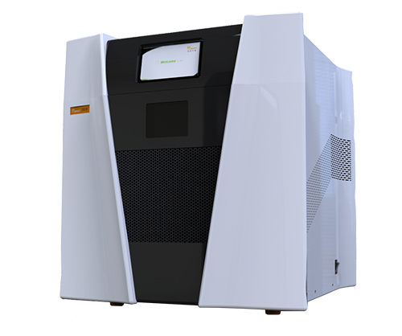
Microwave Digestion/ Extraction Units
MDS-15
01
02
03
04
MASTER
TANK
JUPITER
MDS-6G
05

Slide 6
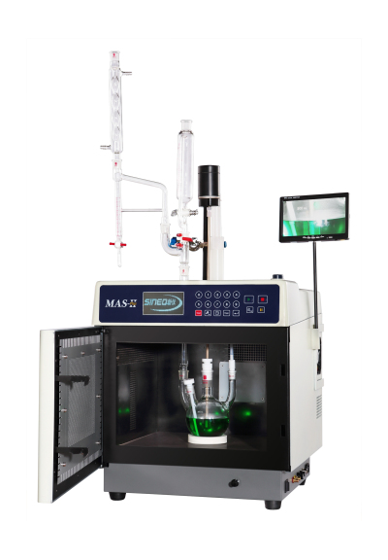
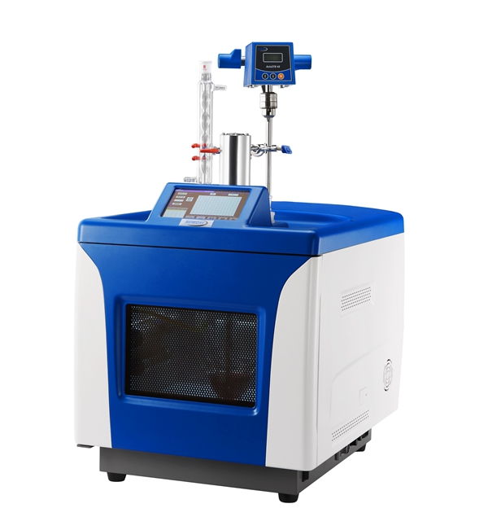
Microwave Synthesis/ Reaction Units
MAS-II PLUS
UWAVE-2000

Slide 7
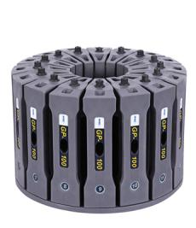
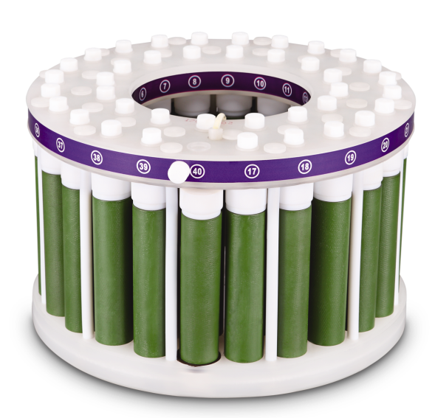
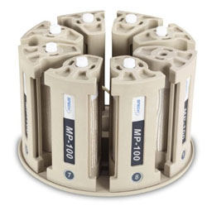
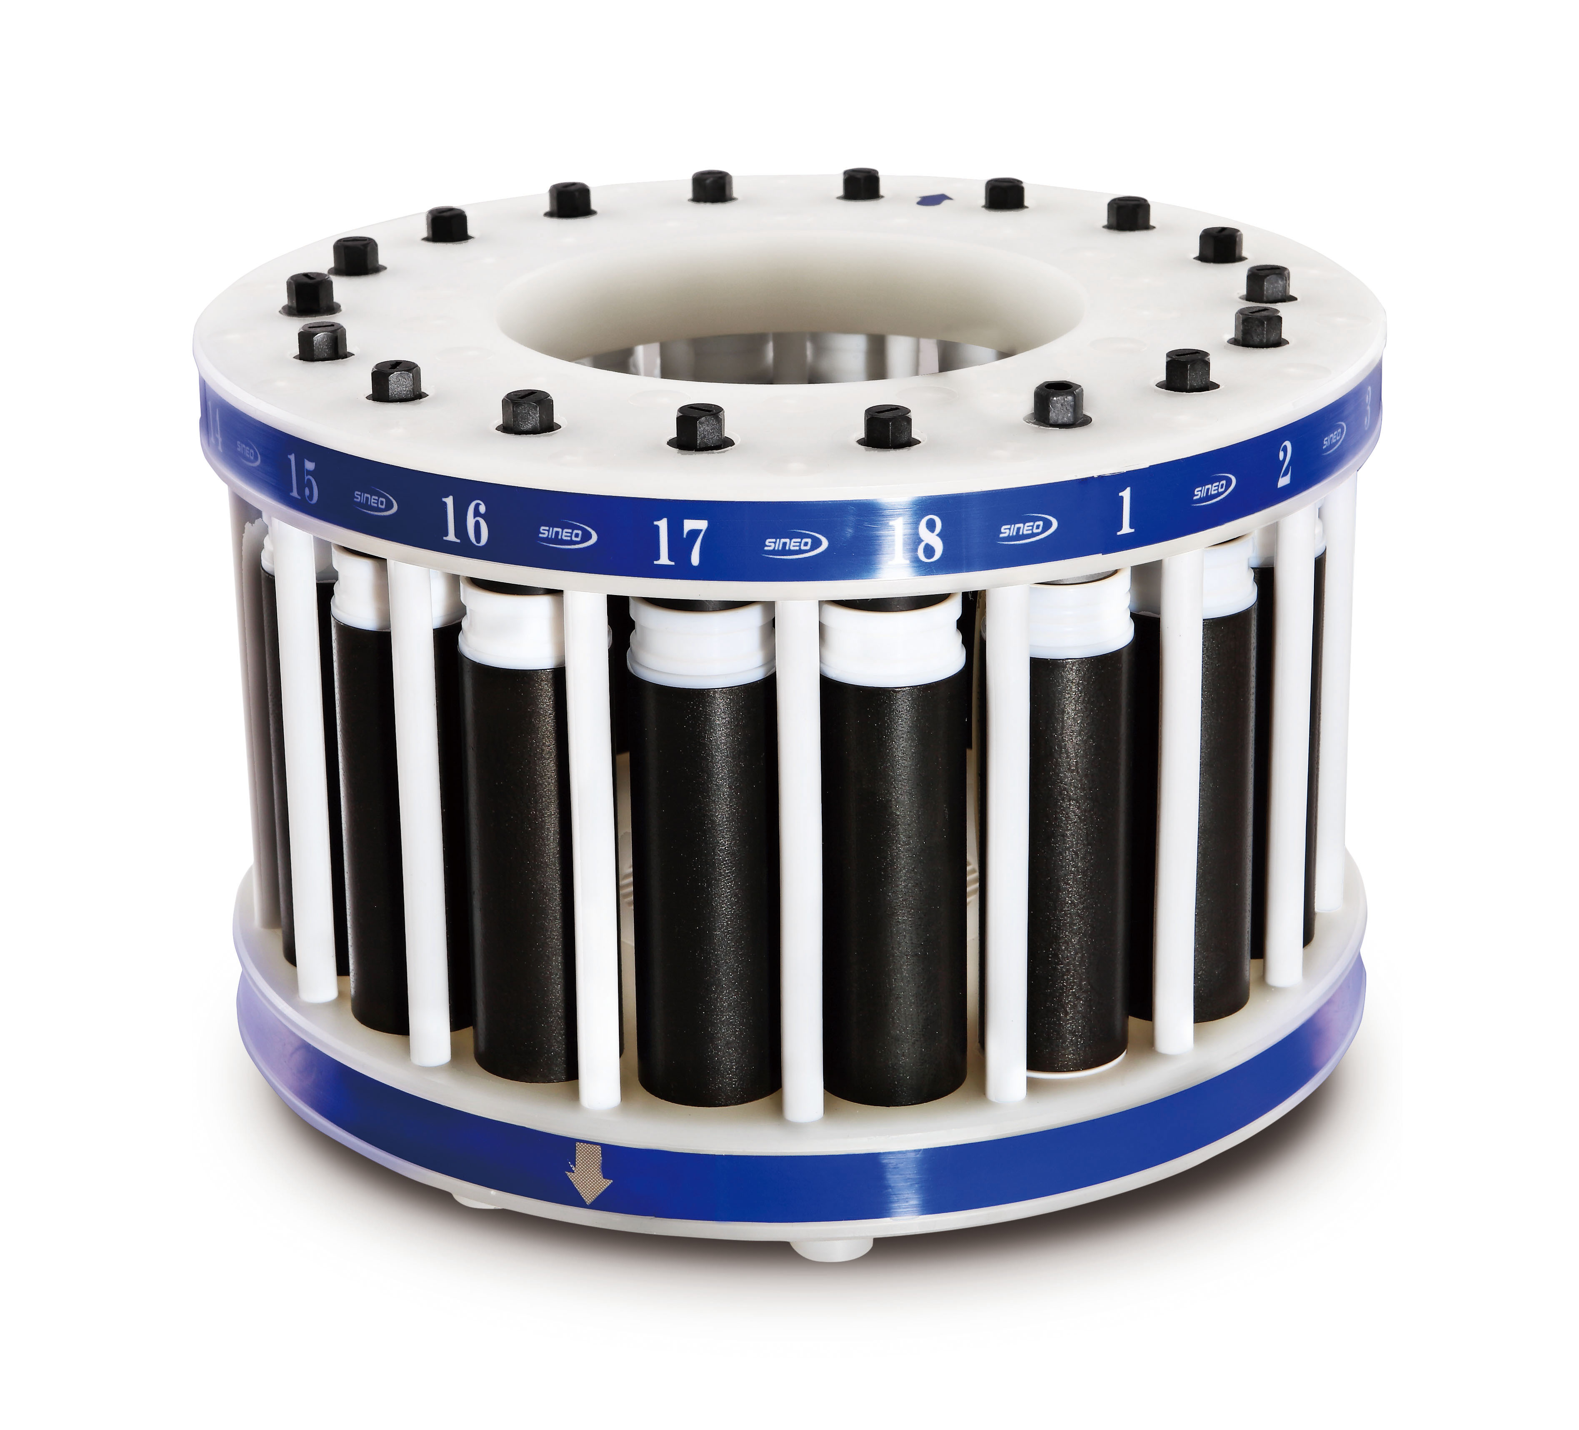
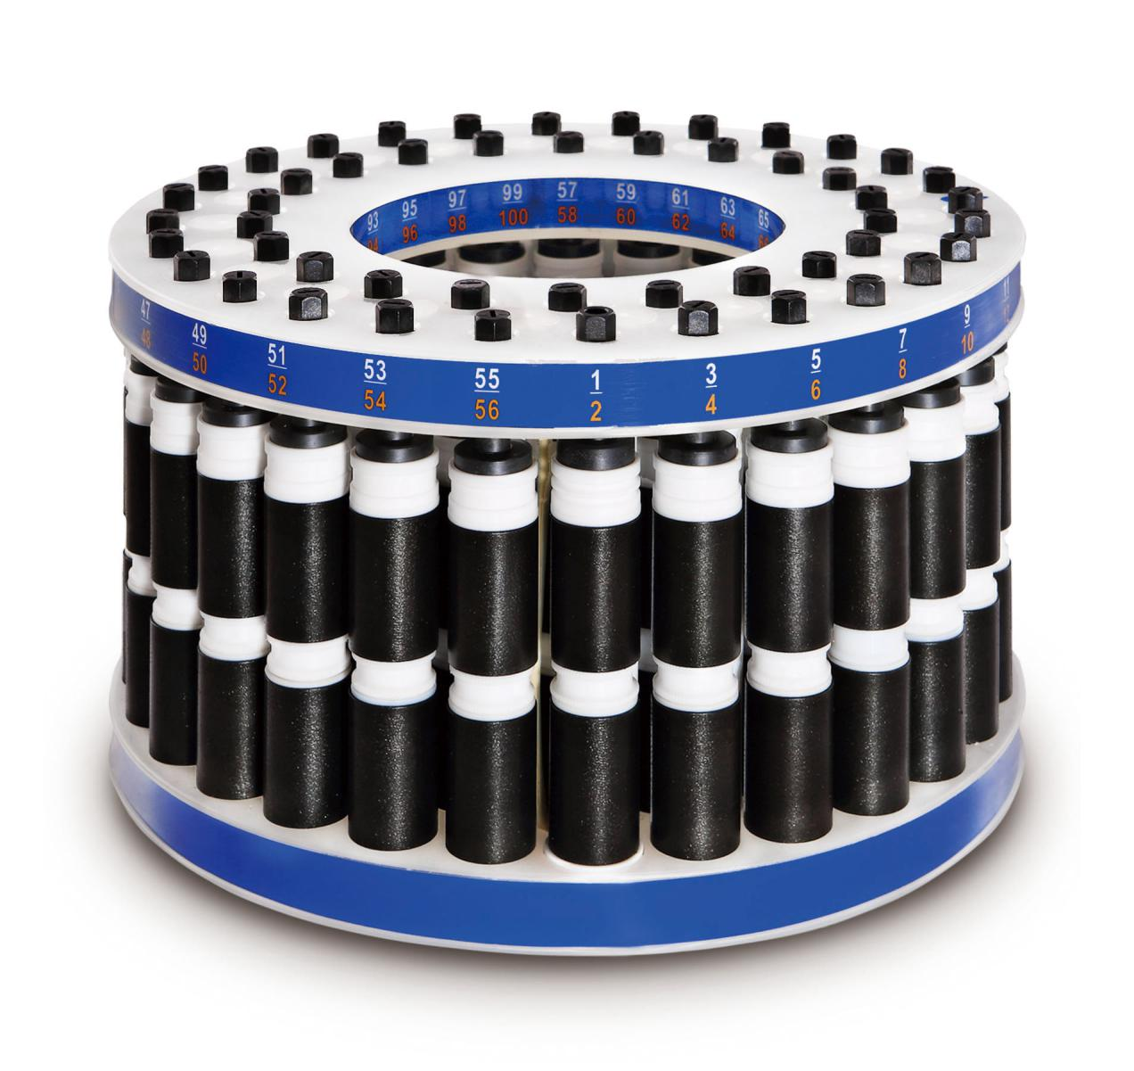
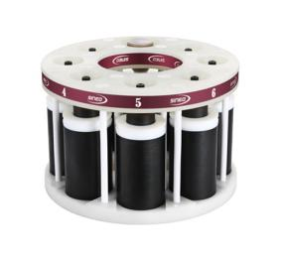
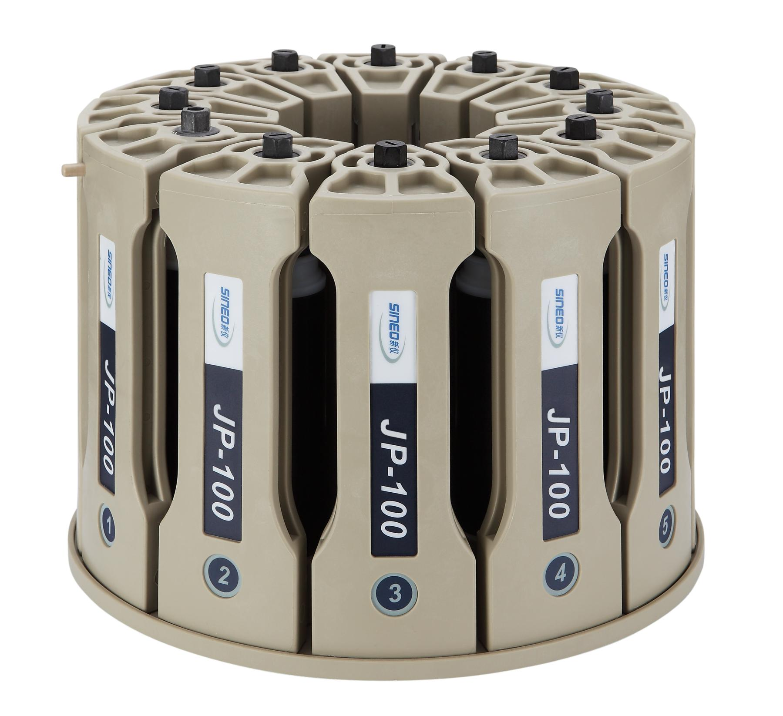
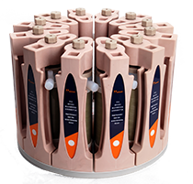
Full-range Vessels

Slide 8
MASTER
Ultra High Throughput Closed Vessel Microwave System
Ultra High throughput Microwave Digestion/ Extraction, One round digestion up to 100 vessels, highest throughput in the world.
Full range vessel option for different applicatioin.

Slide 9
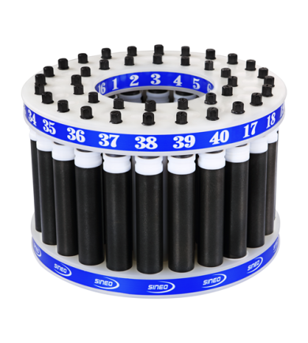
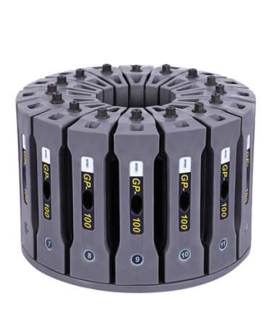
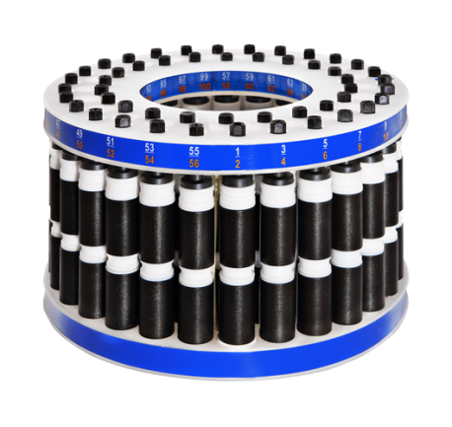
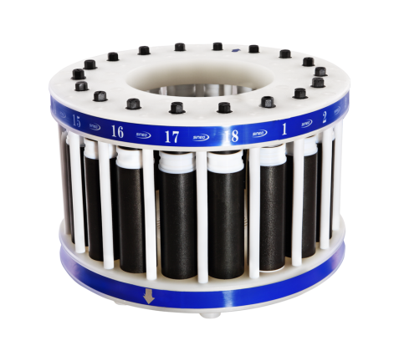
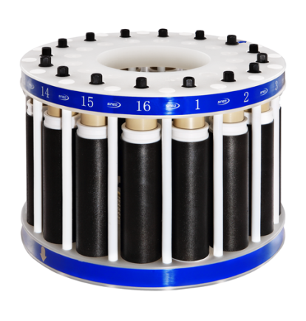
Vessel Option
 | HP-100 | HP-40 | XXP-100 | LV-200 | GP-100
Processing Capacity per Batch | 100 | 40 | 18 | 14 | 16
Max. Pressure | 10Mpa | 10Mpa | 15Mpa | 18Mpa | 16Mpa
Vessel Volume | 15mL, 30mL, 50mL | 45mL, 70mL | 100mL | 200mL | 100mL
Max. Sample Amount | 0.1-0.5g | 0.1-0.5g | 0.5-1.0g | 1.0-2.0g | 0.5-1.0g
Photo

Slide 10
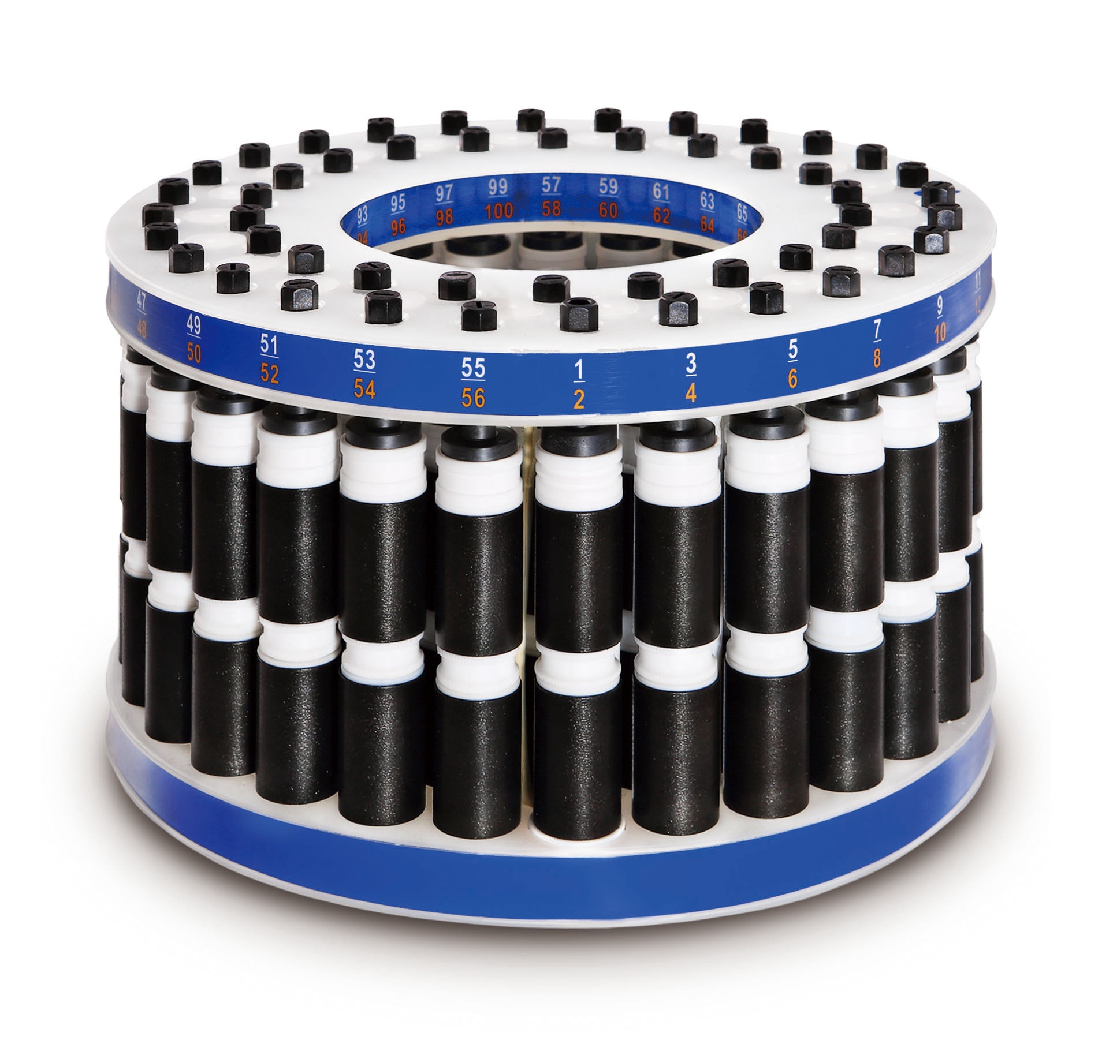
Vessel Feature
One round digestion up to 100 vessels, highest throughput in the world.
High-strength alloy carousel: higher pressure and better digestion performance for high throughput vessel, leaked under the pressure of ≤4MPa and temperature of ≤250℃.

Slide 11
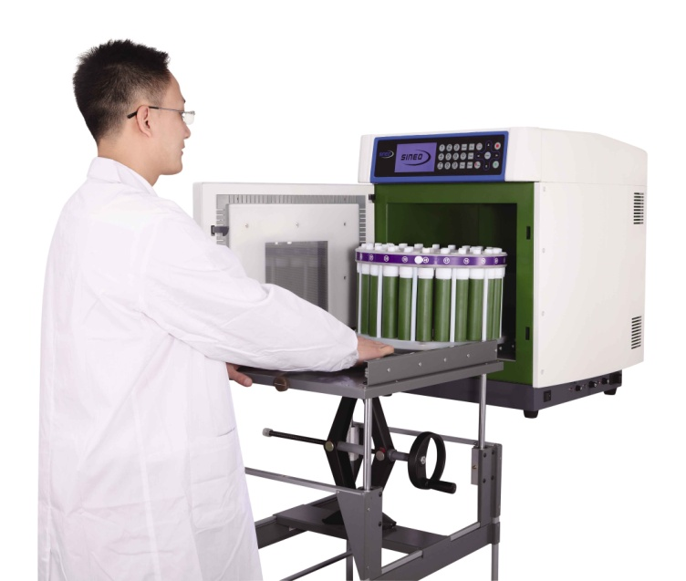
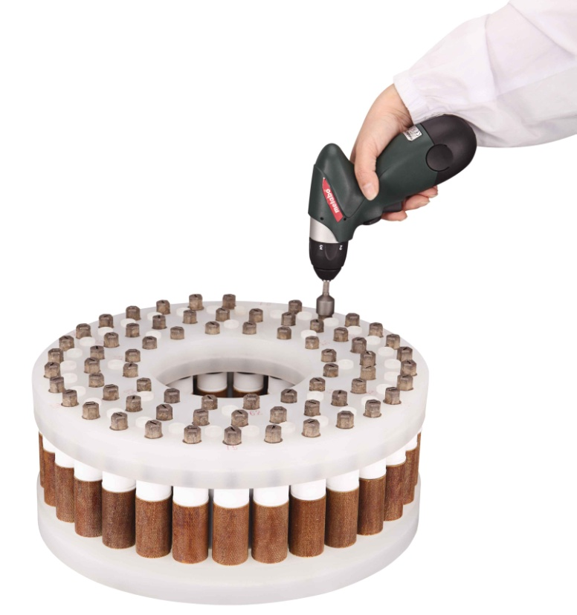
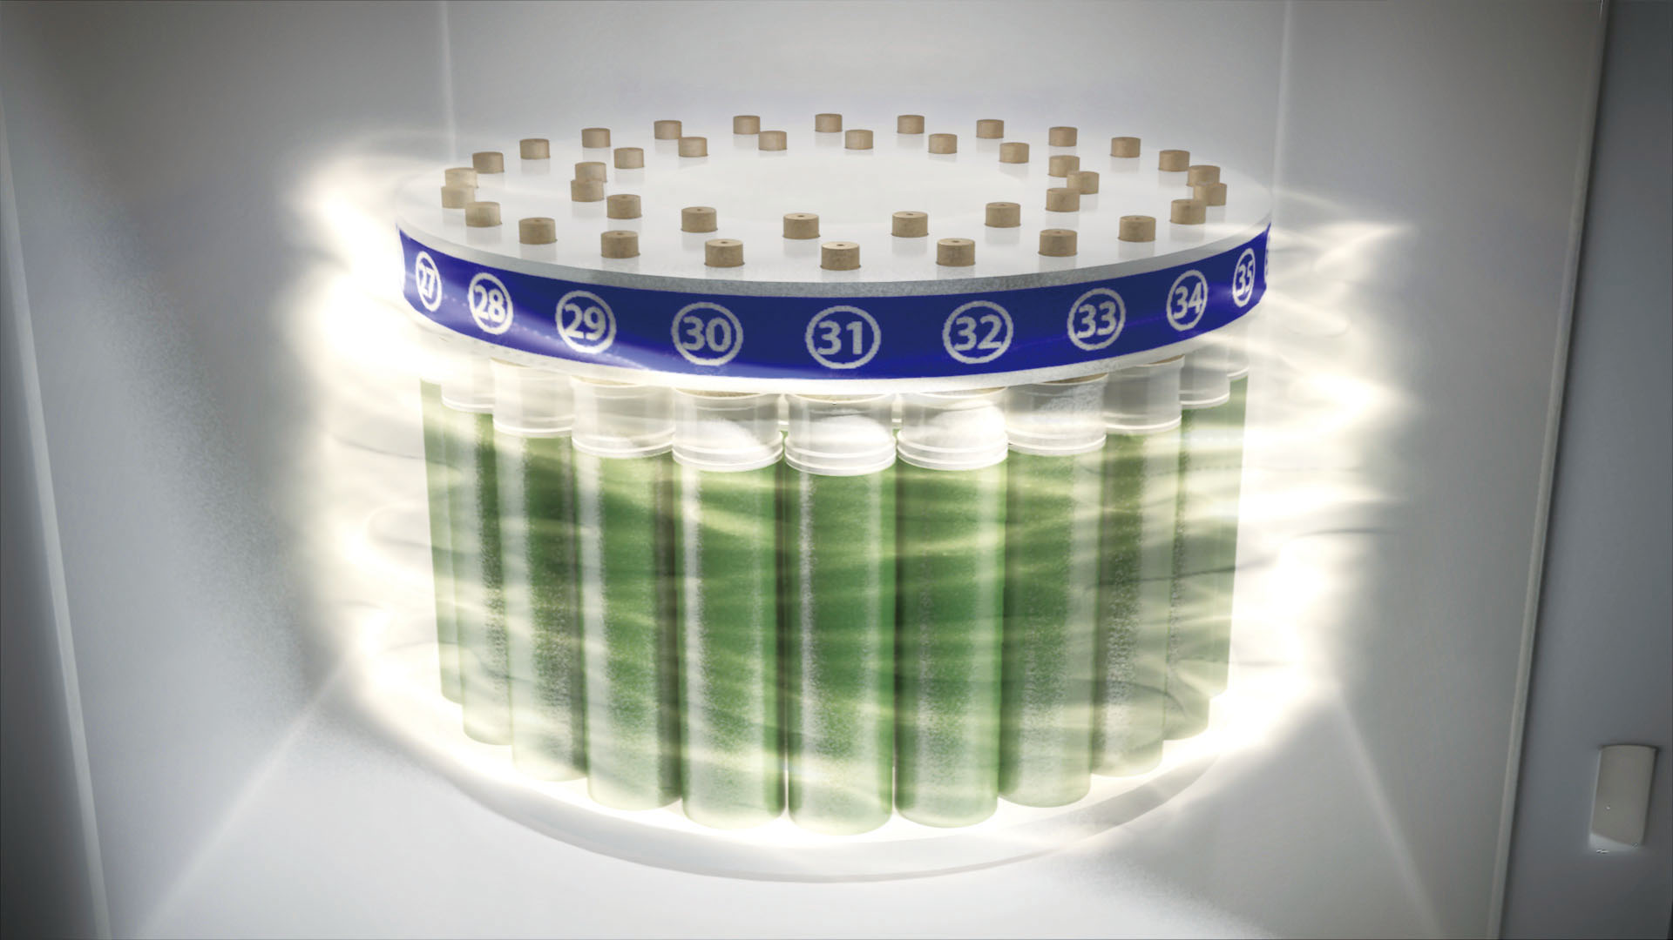
Vessel Feature
UTH-Caro design makes the carousel stir the microwave, guarantee samples digested evenly.
Electric Wrench
(for closing and openning safety bolt)
Liftable Loading Trolley
Note: MDS-15 has nearly same features with MASTER.

Slide 12
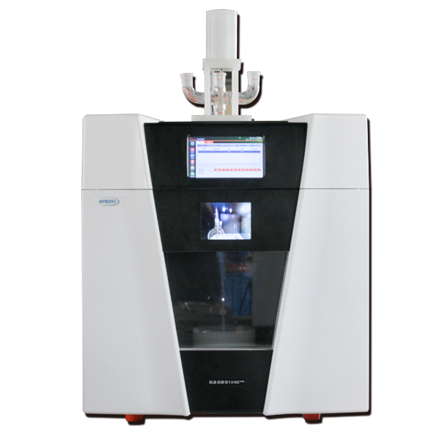
TANK PLUS
Microwave Digestion Workstation
Dual-screen display
7-inch touch screen
4-core 1G operating memory (RAM)
5-inch display, multi-angle observation of internal operation
8G external storage (ROM) Information storage reaches 10 million levels

Slide 13
01
02
03
04
05
Technical Characteristics
TANK PLUS is equipped with Android System, realizing higher convenience for Video SOP, Application Method Management and Parameter Calibration.
Wi-Fi connection and Cloud Services, remote control and sharing of data, method, message and various information.
Security and reliability of data are ensured by electronic signature, audit track and access control functions that meet FDA's relevant requirements.
High accuracy and reliability are realized by direct temperature and pressure monitoring technology.
Experiment safety is ensured as the main control vessel has temperature control function, also equipped with standard IR underneath for the all vessels, realizing real-time monitoring of temperature anomalies in individual vessels.

Slide 14
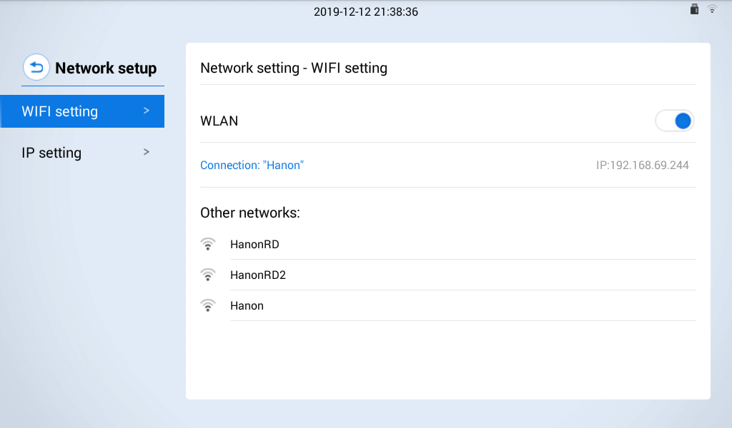
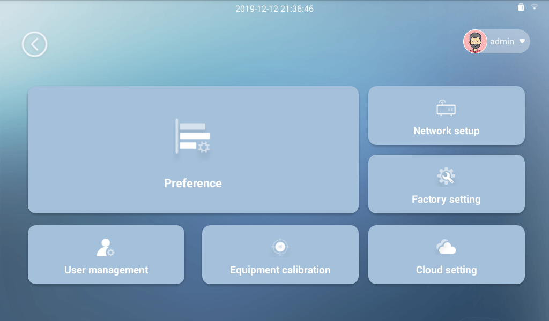
Features
The brand-new PC software supports Wi-Fi connection for remote control. The entire digestion process can be easily controlled in office.
The software has a built-in extraction method library, which can expand the normal pressure / pressure microwave extraction function and provide pretreatment tools for the detection of organic pollutants.
Automatic identification of turntable model and number of vessels: TANK PLUS is compatible with 12 / 40-position turntables. It can automatically recognize and automatically count the number of digestion vessels to adjust the heating power, avoid the tedious manual counting and output to guarantee the experiment more convenient and smooth.

Slide 15
TANK PRO/BASIC
Microwave Digestion Workstation
Modern Design, User-Friendly
Operation remote controlling
Fiber optic temperatrure sensor
Chamber inbuilt camera

Slide 16
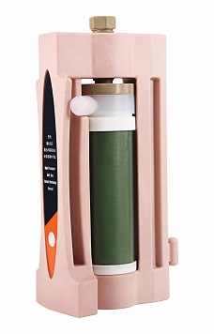
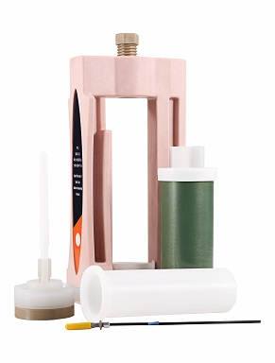
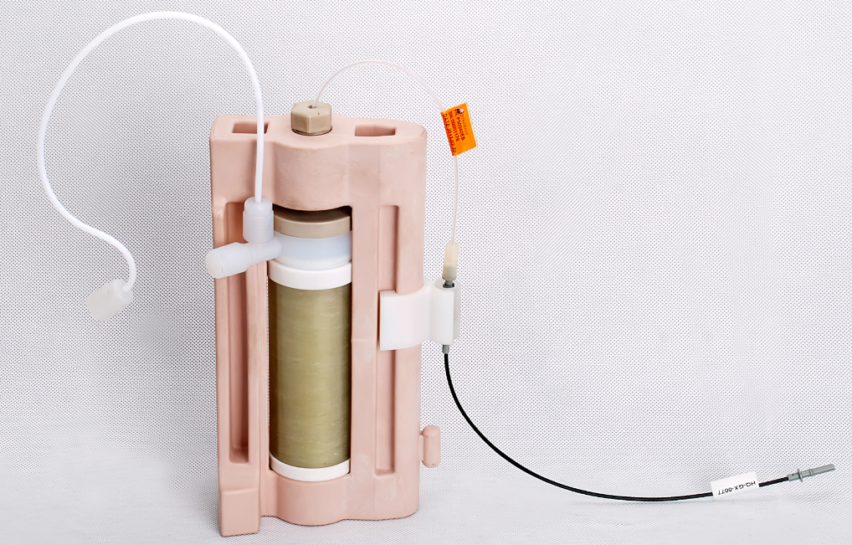
Main Features
Extreme Robust Vessel
Vessel sleeve: Xtra Fiber, up to 80Mpa
Vessel cap: PFA, shape memory material
Vessel screw: PEEK, much safer
Temperature and Pressure Monitoring System
Optical Fiber Sensor
Multicore, 5 times longer than others
Airpipe for Pressure monitor

Slide 17
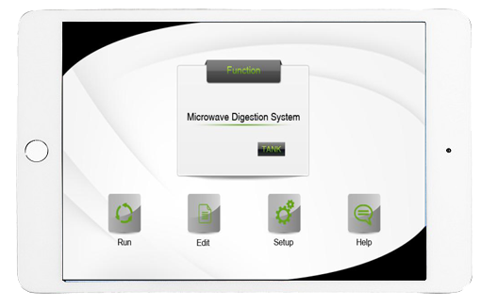
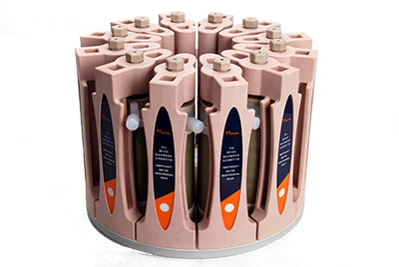
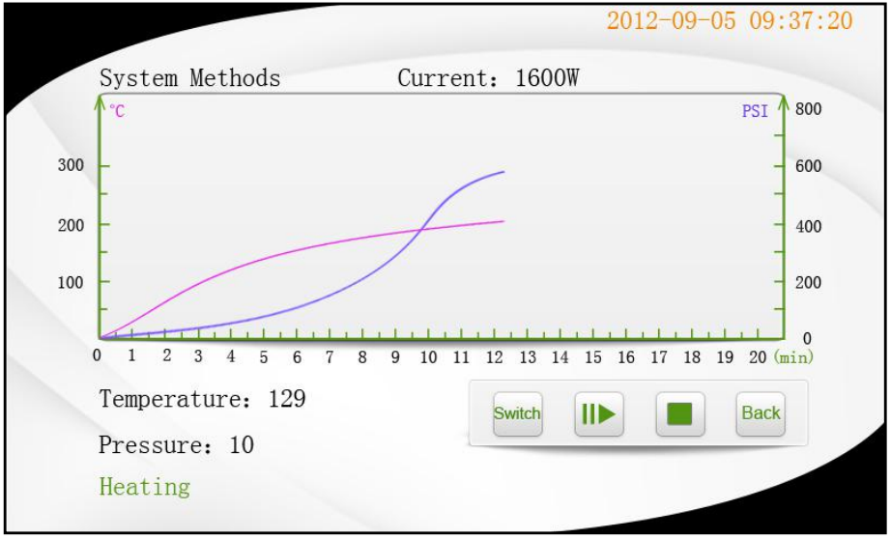
Main Features
Wi-Fi remote control, far away from the Microwave main unit.
Temperature and pressure
showed at real time
12-position Rotor

Slide 18
MDS-6G
Closed Microwave Digestion/Extraction System
Economic model
Basic function
8-position rotor, standard with 6 vessels

Slide 19
VESSELS - High throughput vessels
Up to 40 Vessels; Capacity 45ml, 70ml
Up to 100 Vessels; Capacity 15ml, 30ml, 50ml
Extreme Robust Vessel
Geological samples and biological samples.
Geological samples and biological samples.
HP-100
HP-40

Slide 20
VESSELS - High pressure vessels
TK-100 | MP-100 | JP-100 | XXP-100 | GP-100
12 vessels | 8 vessels | 10/12 vessels | 18 vessels | 16 vessels
15Mpa | 15Mpa | 15Mpa | 18Mpa | 16Mpa
100mL | 100mL | 100mL | 100mL | 100mL
Food and drug (milk and dairy products, health food), cosmetics, agricultural and sideline products, aquatic products, biological tissues, various types of feed, energy and petrochemical, geology and mineral resources, environmental resources (air, water, soil), metals, alloys, ceramics, RoHS, medicine, domestic wastes.

Slide 21
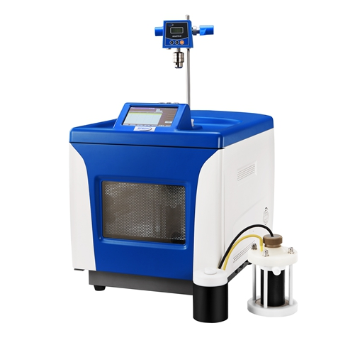
UWAVE-2000
Multifuctional Microwave Chemistry platform
Integrated with open and pressurized reaction
Microwave/ Ultraviolet/ Ultrasonic wave 3 IN 1
7”LCD touch screen, intelligent software, safe
and remote control
Maximum reaction volume of 2000ml open vessel
and 500ml closed vessel

Slide 22
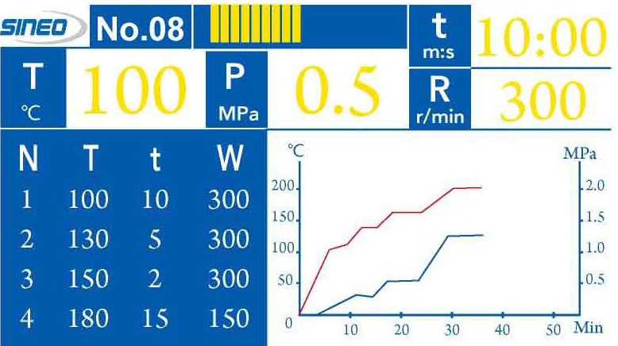
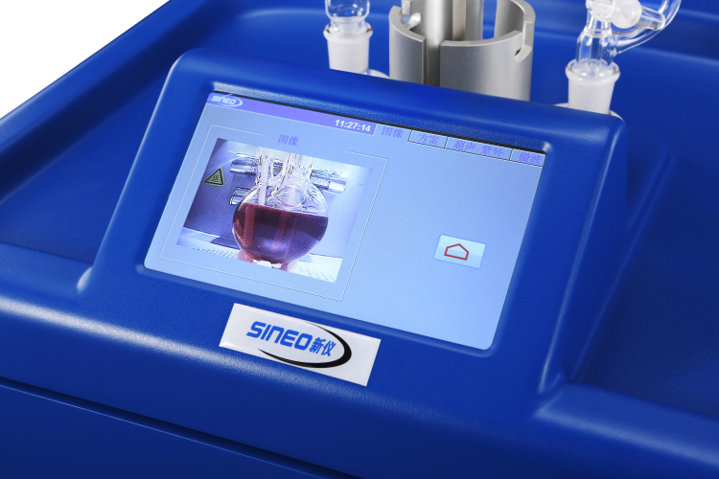
Main Features
Color display showing reaction parameter and curve in real-time
Video system to monitor the reaction visually
Color display showing reaction parameter and curve in real-time

Slide 23
MAS-II PLUS
Multi-Purpose Microwave Synthesis Extractor
Intake of inert protective gas
Non-pulse continuous microwave heating
Two pages parameter and accelerating curve display
Two channels temperature monitoring (for different medium)
Mechanical and magnetic stirring (speed adjustable and visible)

Slide 24
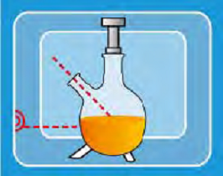
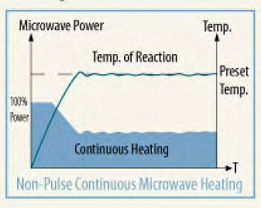
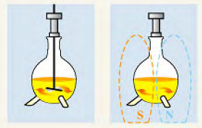
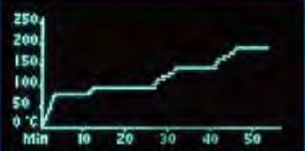
Main Features
Patented technology to monitor inside temperature via IR sensor.
Non-pulse continuous microwave power through Inverter technology
Both mechanical and magnetic stirring
Two pages instant display of both reaction parameters and accelerating curve

Slide 25
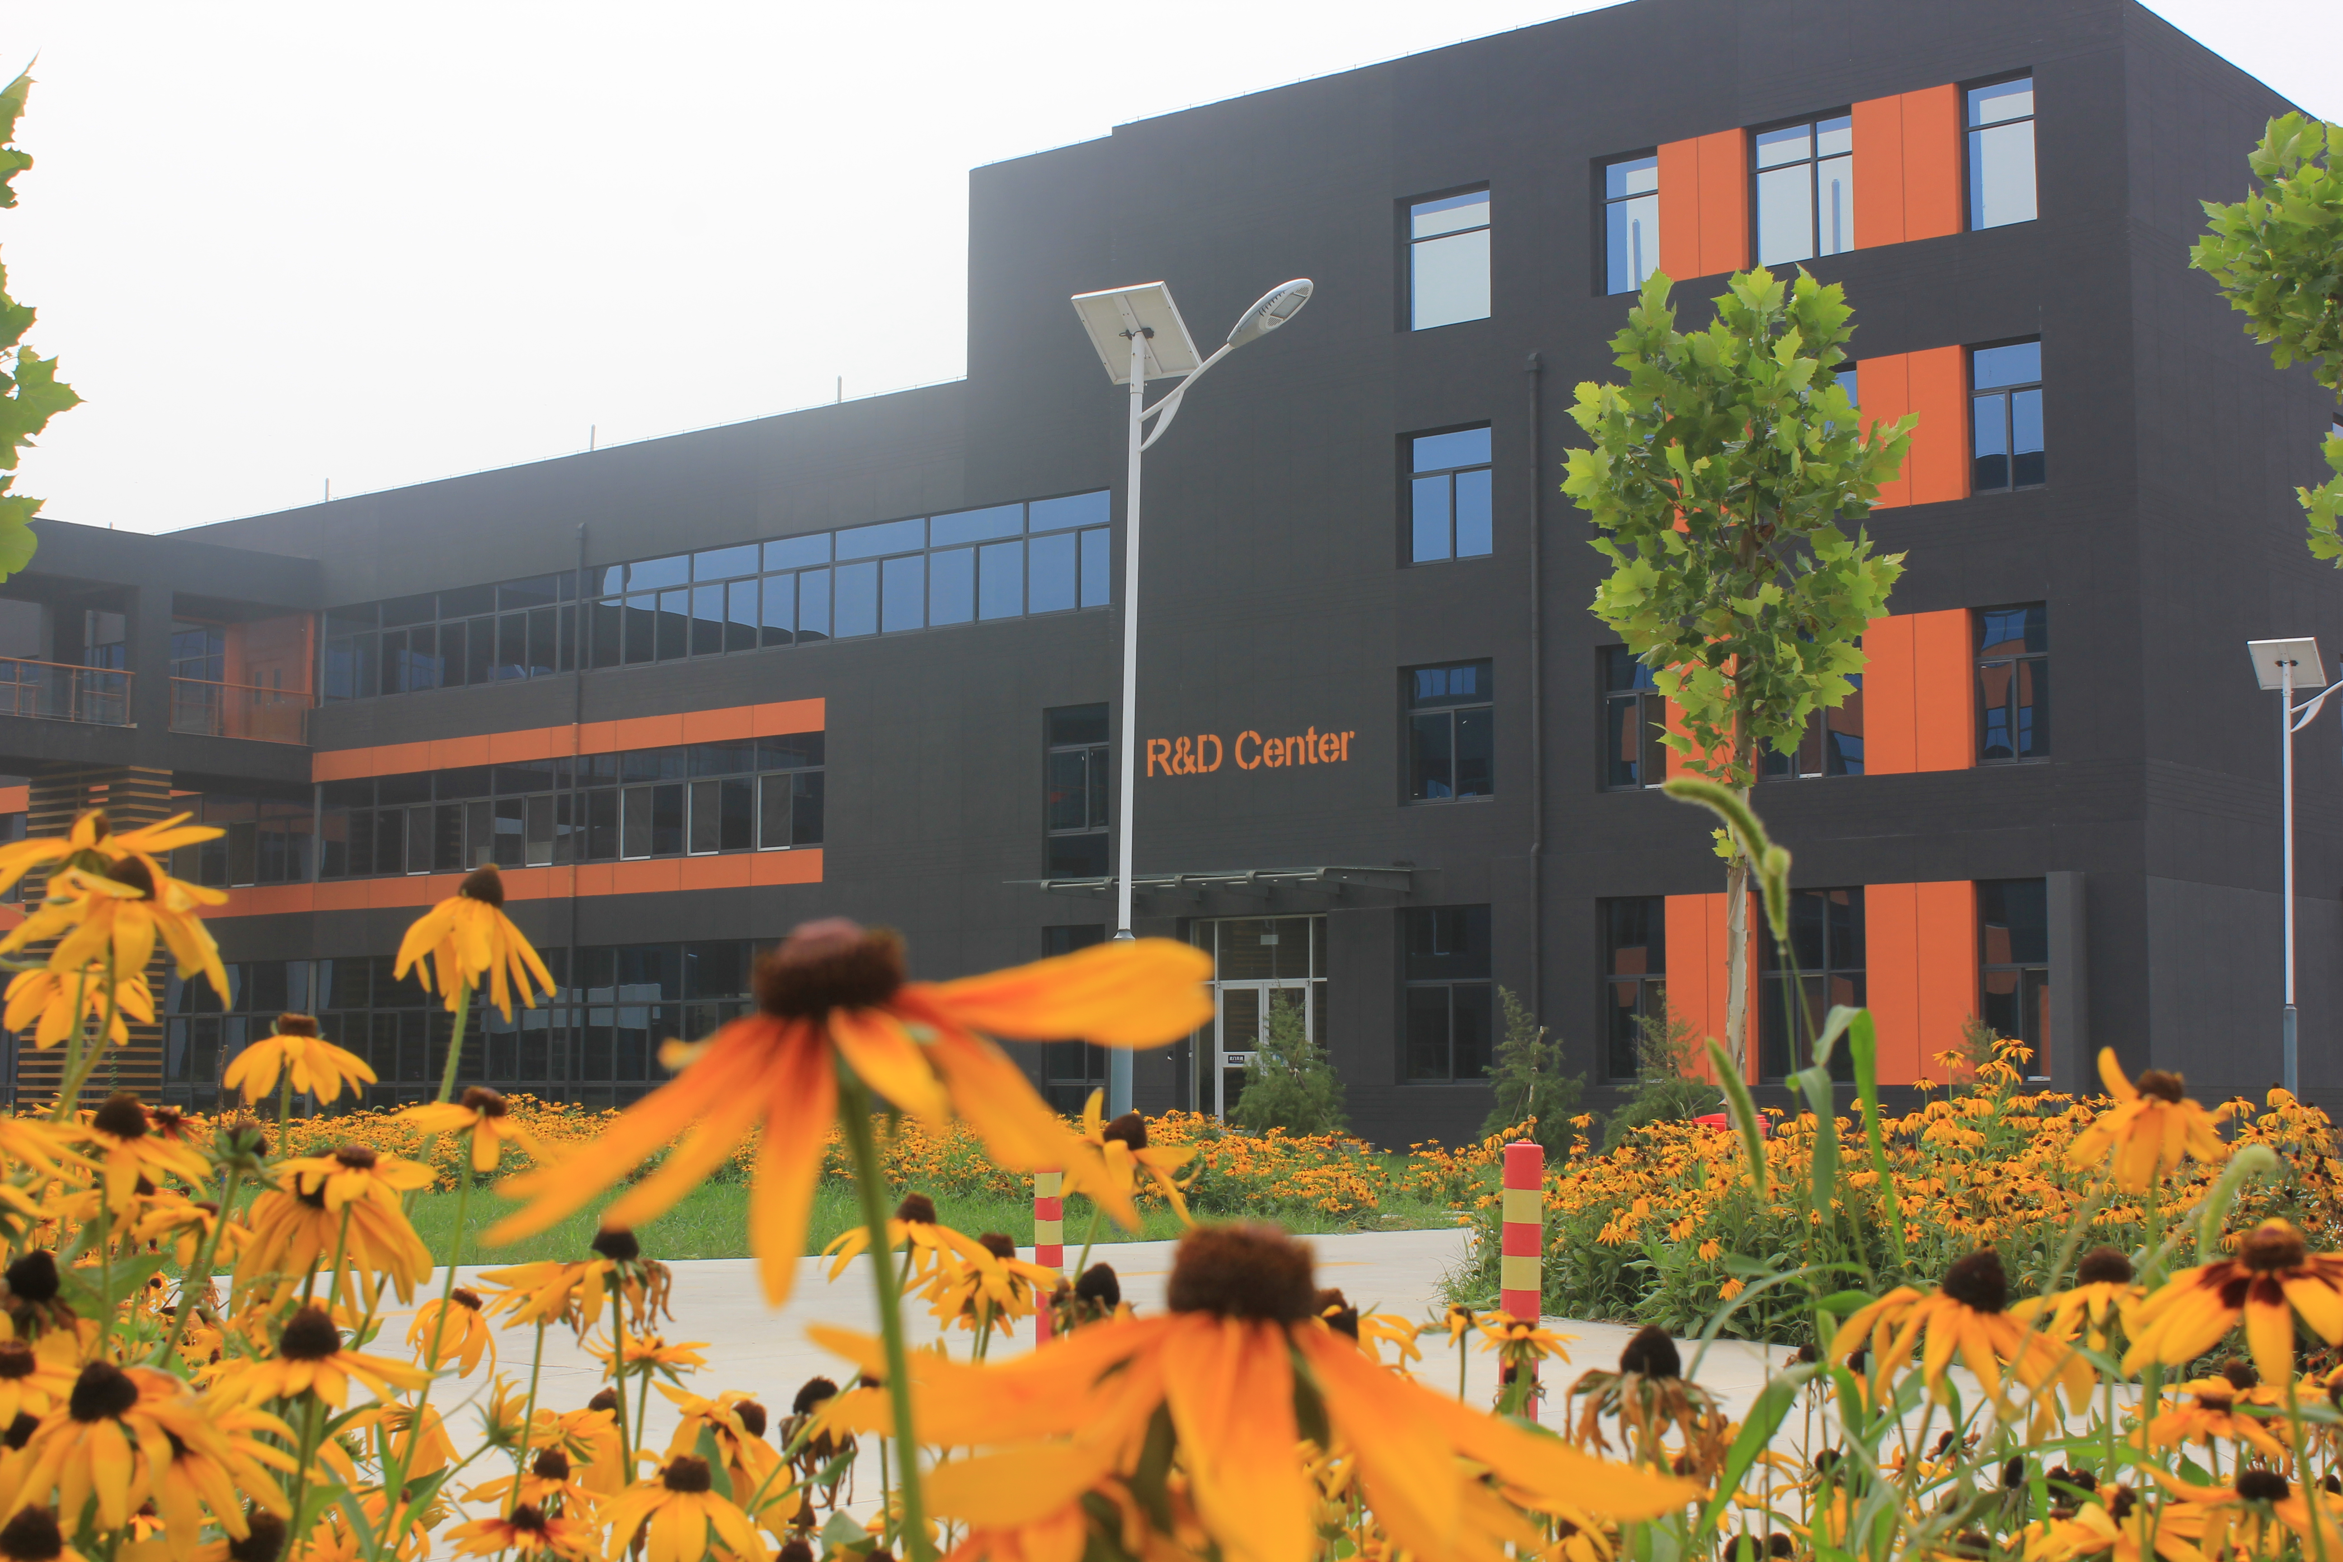
#03
ADVANTAGE

Slide 26
What We Have?
01
03
18000㎡ Modern Manufacturing Workshop
Full-range Series
02
03
02
Technology Strength
04
Different Temperature/Pressure Control Methods
Different Configuration Options
Production Capacity/Quality Controlling/Delivery Time
01
04
Service & Support
Microwave heating-high efficiency and precise control
Vessel Materials
Exhibition/Seminar
On-site & On-line Training

Slide 27
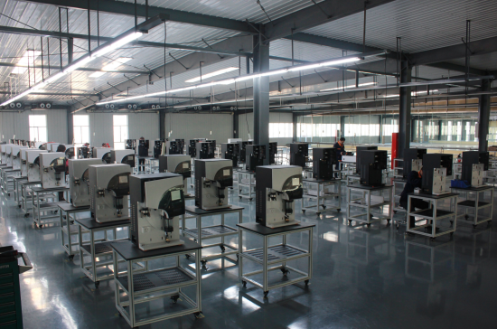
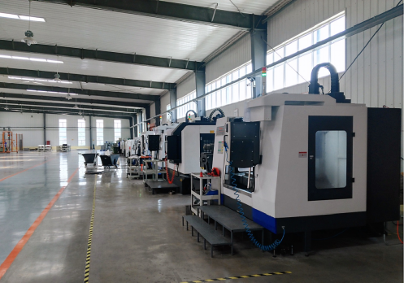
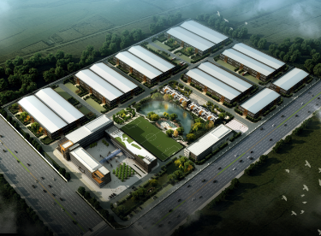
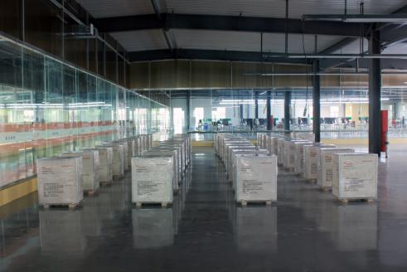
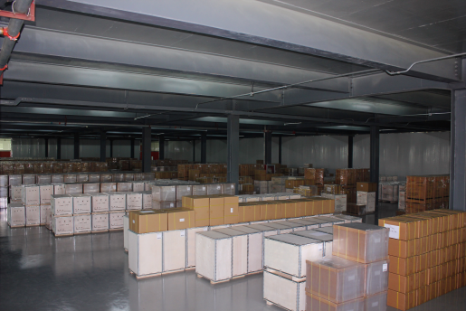
Manufacturing Workshop
18000㎡ Manufacturing Base
R&D Building
Workshop I
Workshop II
....
Panorama

Slide 28
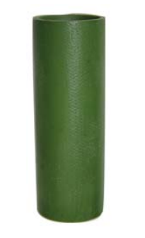
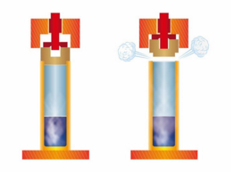
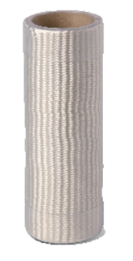
Full Body PFA Coating
Technology Strength
Safety Bolt Design(Patented)
VS
Junction Box (Patented)
High Productivity with High Pressure
High-strength alloy carousel (Pressure up to 4Mpa, temperature up to 250℃)

Slide 29
Full-range Series
SERIES | MDS-6G | JUPITER | MDS-15 | MASTER | TANK | TANK PLUS
Installed Power | 1800W | 1800W | 3600W | 3600W | 2850W | 3800W
Max Microwave Output Power | 1000W | 1300W | 1800W | 2200W | 1600W | 2000W
Processing Capacity | 6/8 | 8/10 | 16 | 16/18/40/100 | 12 | 12/40
Vessel Volume / ml | 100 | 100 | 100 | 100/100/70/20 | 100 | 100/70
Temperature Control | Pt Sensor | Pt Sensor | Pt Sensor | Pt Sensor & IR | Optical Fiber | IR & Optical Fiber
Pressure Control | Piezoelectric Cristal Sensor | Piezoelectric Cristal Sensor | Piezoelectric Cristal Sensor | Piezoelectric Cristal Sensor | Pressure Pipe (Ideal Gas) | Pressure Pipe (Ideal Gas)

Slide 30
12 Experienced Application Engineers
Service & Support
35 Professional Technical Engineers
100 Sets of Specific Development Equipment
1500 Square Meters Modern Professional Laboratory
Local Exhibition & Seminar Support
Demo Units & Marketing Material
On-site & On-line Training

Slide 31
THANK YOU!

